Slide 2
Logistic Regression
Logistic regression is a statistical method used for binary classification that predicts the probability of a binary outcome (0 or 1) based on one or more predictor variables. Unlike linear regression, which is used for predicting continuous outcomes, logistic regression is specifically designed to handle situations where the response variable is categorical.

Slide 3
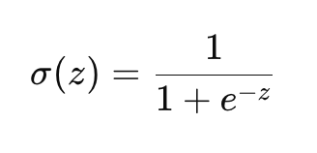
Key Concepts
Binary Classification: Logistic regression is typically used to classify observations into two distinct categories, such as yes/no, success/failure, or spam/ham.
Logistic Function (Sigmoid Function): The core of logistic regression is the logistic function, also known as the sigmoid function, which maps any real-valued number into a value between 0 and 1. The logistic function is defined as:
where 𝑧 is a linear combination of the input features.

Slide 4
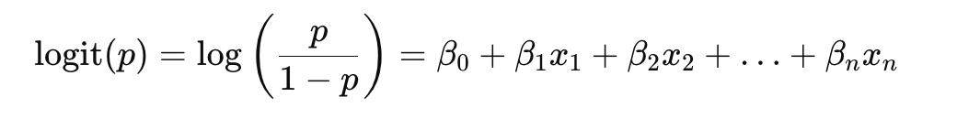
Odds and Log-Odds: Logistic regression models the log-odds of the probability of the outcome as a linear combination of the predictor variables. The log-odds (or logit) function is given by:
where 𝑝 is the probability of the outcome being 1, and 𝛽0,𝛽1,…,𝛽𝑛 are the coefficients of the model.
Maximum Likelihood Estimation (MLE): The parameters (coefficients) of the logistic regression model are estimated using maximum likelihood estimation, which finds the values that maximize the likelihood of observing the given sample data.

Slide 5
Key Differences with Linear Regression
Feature | Linear Regression | Logistic Regression
Outcome Variable | Continuous | Binary (0 or 1)
Model Equation | 𝑦=𝛽₀+𝛽₁𝑥₁+…+𝛽_{𝑛}𝑥_{𝑛} | log(𝑝/1−𝑝)=𝛽₀+𝛽₁𝑥₁+…+𝛽_{𝑛}𝑥_{𝑛}
Output | Continuous value | Probability (between 0 and 1)
Link Function | Identity | Logistic (Sigmoid)
Error Structure | Normally distributed residuals | Binomial distribution of the outcome
Objective Function | Minimize sum of squared errors (SSE) | Maximize likelihood (MLE)
Interpretation of Coefficients | Change in outcome per unit change in predictor | Change in log-odds per unit change in predictor
Applicability | Continuous, normally distributed outcomes | Binary or categorical outcomes

Slide 6
Binary Classification Problem
A binary classification problem is a type of supervised learning task where the goal is to classify instances into one of two distinct classes. Each instance is represented by a set of features (input variables), and the objective is to predict the class label (output) for each instance based on these features. The two classes are typically denoted as 0 and 1, or negative and positive, or any other two distinct labels.

Slide 7
Need for Logistic Regression
Probability Output
Prediction of Probabilities: Logistic regression provides a probabilistic framework for binary classification. It outputs probabilities that an instance belongs to a particular class, which can then be converted into a binary decision using a threshold (e.g., 0.5). This is useful in scenarios where the certainty of the prediction is important.
Interpretability: The probabilistic output is interpretable and can be used to understand the confidence of the model in its predictions.

Slide 8
Need for Logistic Regression
Appropriate for Binary Outcomes
Handling of Binary Outcomes: Logistic regression is specifically designed for binary outcomes, where the target variable is categorical with two possible values (e.g., 0 and 1). It models the log-odds of the probability of the positive class and is tailored to handle the properties of binary data.
Direct Modeling of Binary Data: It is well-suited for tasks where the outcome is binary, unlike linear regression which assumes a continuous outcome and can produce nonsensical predictions when applied to binary data.

Slide 9
Need for Logistic Regression
Log-Odds and Sigmoid Function
Logistic Function: The logistic (sigmoid) function used in logistic regression maps any real-valued number into the (0, 1) interval, ensuring that the predicted probabilities are valid. This transformation is crucial for binary classification problems.
Log-Odds Interpretation: Logistic regression models the relationship between the input features and the log-odds of the binary outcome, providing a clear interpretation of how each feature influences the probability of the outcome.

Slide 10
Need for Logistic Regression
Linear Decision Boundary
Linear Separability: Logistic regression finds a linear decision boundary in the feature space, making it simple and efficient for problems where classes are linearly separable. While it might not capture complex relationships as well as some other methods, its simplicity and efficiency make it a good starting point.

Slide 11
Need for Logistic Regression
Well-Established Statistical Properties
Maximum Likelihood Estimation (MLE): Logistic regression uses MLE to estimate the model parameters, which has well-understood statistical properties. This provides a robust theoretical foundation for the model and helps in understanding the uncertainty associated with the parameter estimates.
Hypothesis Testing: The framework allows for statistical hypothesis testing of the model coefficients, which can be used to assess the significance of each predictor variable.

Slide 12
Need for Logistic Regression
Preventing Overfitting: Logistic regression can be extended with regularization techniques (like L1 and L2 regularization) to prevent overfitting, especially when dealing with high-dimensional data. Regularization adds a penalty for large coefficients, promoting simpler models that generalize better to new data.

Slide 13
Logistic Function and its Role
It is used to map predicted values (which can range from negative to positive infinity) to a probability value between 0 and 1. This makes it ideal for binary classification tasks where the output needs to represent the probability of belonging to a specific class.

Slide 14
Properties of the Logistic Function
Range: The logistic function outputs values between 0 and 1 for all input values from negative to positive infinity.
S-Shape (Sigmoid Curve): The function has an S-shaped curve, asymptotically approaching 0 as 𝑧 goes to negative infinity and approaching 1 as 𝑧 goes to positive infinity.
Monotonic: The function is monotonically increasing, meaning as 𝑧 increases, the output of the logistic function also increases.

Slide 15
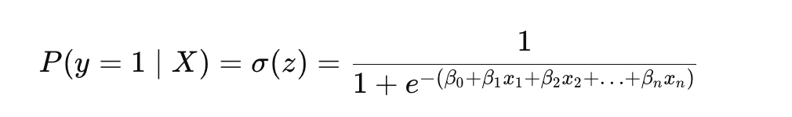
Role of the Logistic Function in Logistic Regression
Probability Mapping: In logistic regression, the logistic function maps the linear combination of input features to a probability value between 0 and 1. This probability represents the likelihood that the given instance belongs to the positive class (class 1).

Slide 16
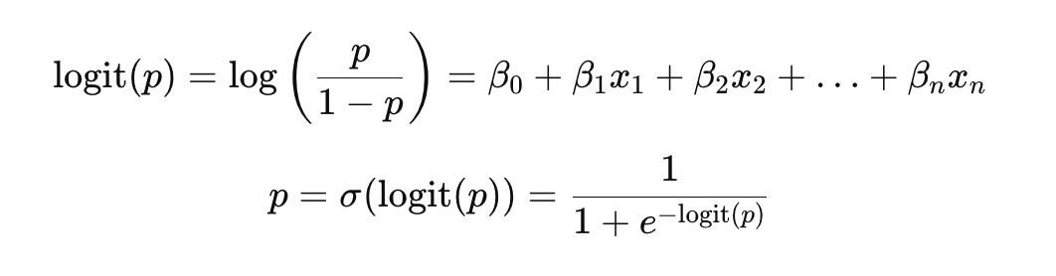
Role of the Logistic Function in Logistic Regression
Log-Odds Transformation: The logistic regression model predicts the log-odds of the positive class as a linear combination of the input features. The log-odds (logit) are transformed into a probability using the logistic function.

Slide 17
Role of the Logistic Function in Logistic Regression
Interpretation of Coefficients: The coefficients (𝛽 values) in the logistic regression model represent the change in the log-odds of the outcome for a one-unit change in the corresponding predictor variable. By applying the logistic function to these log-odds, we get the corresponding probability.
Decision Threshold: The output of the logistic function can be compared to a threshold (commonly 0.5) to make binary classification decisions. If the output probability is greater than or equal to the threshold, the instance is classified as the positive class; otherwise, it is classified as the negative class.

Slide 18
Best-fit curve via coefficient adjustment
Finding the best-fit curve via coefficient adjustment in logistic regression involves determining the values of the coefficients (𝛽₀,𝛽₁,𝛽₂,…,𝛽𝑛) that minimize the difference between the predicted probabilities and the actual outcomes in the training data. This process is typically done using a method called Maximum Likelihood Estimation (MLE).

Slide 19
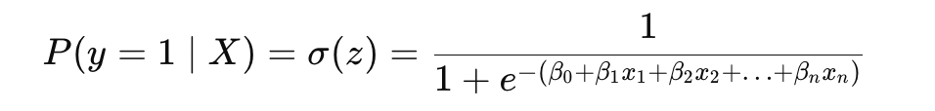
Steps to Find the Best-Fit Curve
Model Specification: Define the logistic regression model, where the probability of the binary outcome is given by:
Here, 𝑧 is the linear combination of input features and their corresponding coefficients.

Slide 20
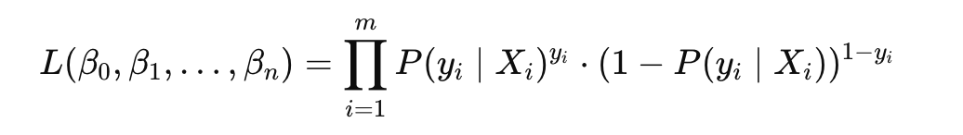
Steps to Find the Best-Fit Curve
Likelihood Function: The likelihood function represents the probability of observing the given data as a function of the model parameters (coefficients). For logistic regression, the likelihood of the observed data is:
where 𝑚 is the number of training examples, 𝑦𝑖​ is the actual outcome (0 or 1) for the 𝑖-th instance, and 𝑃(𝑦𝑖∣𝑋𝑖) is the predicted probability for the 𝑖-th instance.

Slide 21
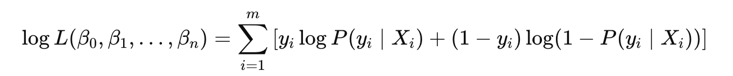
Steps to Find the Best-Fit Curve
Log-Likelihood Function: To simplify the computation, we usually work with the log-likelihood function, which is the natural logarithm of the likelihood function. This transformation converts the product into a sum:

Slide 22
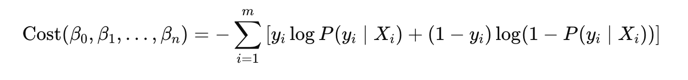
Steps to Find the Best-Fit Curve
Objective Function: The goal is to find the coefficients that maximize the log-likelihood function. This is equivalent to minimizing the negative log-likelihood (also known as the cost function or loss function):

Slide 23
Steps to Find the Best-Fit Curve
Gradient Descent: Iteratively updates the coefficients in the direction that reduces the cost function, using the gradient (partial derivatives) of the cost function with respect to each coefficient.
Newton-Raphson Method: An iterative optimization algorithm that uses both the gradient and the Hessian matrix (second-order derivatives) to find the coefficients that maximize the log-likelihood.

Slide 24
Odds, Log Odds, and Probabilities
Probability is a measure of the likelihood that a particular event will occur. In the context of logistic regression for binary classification, the probability (𝑝) represents the likelihood that a given instance belongs to the positive class (e.g., class 1).
If 𝑝=0, the event is certain not to occur.
If 𝑝=1, the event is certain to occur.
If 𝑝=0.5, the event is equally likely to occur or not occur.

Slide 25
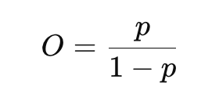
Odds, Log Odds, and Probabilities
Odds provide a different way to express probabilities. The odds of an event are defined as the ratio of the probability that the event will occur to the probability that it will not occur. Mathematically, the odds (𝑂) are given by:
where 𝑝 is the probability of the event occurring.
If 𝑝=0.5, the odds are 1:1 (or simply 1), meaning the event is equally likely to occur as not occur.
If 𝑝=0.75, the odds are 3:1, meaning the event is three times as likely to occur as not occur.
If 𝑝=0.25, the odds are 1:3, meaning the event is one-third as likely to occur as not occur.

Slide 26
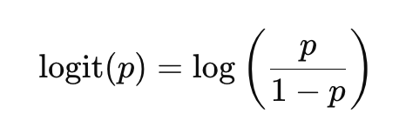
Odds, Log Odds, and Probabilities
Log-Odds (Logit)
In logistic regression, the model predicts the log-odds (also called the logit) of the probability of the positive class. The log-odds are the natural logarithm of the odds:
The log-odds transform the bounded probability values (0 to 1) to an unbounded scale (-∞ to +∞), which is more suitable for modeling with linear functions.

Slide 27
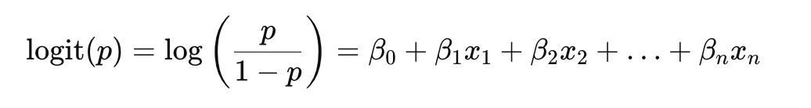
Odds, Log Odds, and Probabilities
Logistic Regression Model
The logistic regression model is formulated in terms of the log-odds. It expresses the log-odds as a linear combination of the input features:
Here, 𝛽₀,𝛽₁,…,𝛽_{𝑛} are the coefficients of the model, and 𝑥₁,𝑥₂,…,𝑥_{𝑛}​ are the input features.

Slide 28
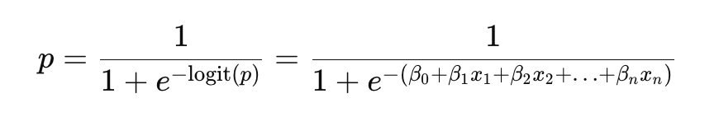
Odds, Log Odds, and Probabilities
Converting Log-Odds Back to Probability
To convert the log-odds back to a probability, we use the logistic (sigmoid) function:
This function maps the linear combination of input features to a value between 0 and 1, representing the predicted probability of the positive class.

Slide 29
Selection of Threshold
Factors Influencing Threshold Selection
Class Imbalance:
In cases where the classes are imbalanced (one class is much more frequent than the other), using a 0.5 threshold may not be appropriate. For instance, in medical diagnostics where the occurrence of a disease is rare, a lower threshold might be chosen to ensure that more positive cases are detected.
Costs of False Positives and False Negatives:
The consequences of misclassifications can significantly influence the threshold choice. If the cost of a false negative (failing to detect a positive case) is higher than a false positive (incorrectly predicting a positive case), a lower threshold might be chosen to reduce false negatives. Conversely, if false positives are more costly, a higher threshold might be used.
Precision and Recall:
Precision and recall are metrics that can guide threshold selection. Precision measures the proportion of true positive predictions among all positive predictions, while recall measures the proportion of true positive predictions among all actual positives. Depending on whether precision or recall is more important, the threshold can be adjusted accordingly.

Slide 30
Techniques for Determining Optimal Threshold
Receiver Operating Characteristic (ROC) Curve:
The ROC curve plots the true positive rate (recall) against the false positive rate for different threshold values. The Area Under the ROC Curve (AUC) is a measure of the model's performance. By analyzing the ROC curve, one can select a threshold that balances the trade-off between true positives and false positives.
Precision-Recall (PR) Curve:
The PR curve plots precision against recall for different thresholds. This is particularly useful for imbalanced datasets. The optimal threshold can be chosen based on the desired balance between precision and recall.
F1 Score:
The F1 score is the harmonic mean of precision and recall. It provides a single metric to evaluate the balance between precision and recall. The threshold that maximizes the F1 score can be chosen to balance these two metrics.
Cost-Benefit Analysis:
A cost-benefit analysis can be performed by assigning specific costs to false positives and false negatives. The optimal threshold can then be chosen to minimize the total cost.

Slide 31
Impact on Performance Metrics
Accuracy:
Accuracy measures the proportion of correctly classified instances (both true positives and true negatives) out of the total instances. Changing the threshold can alter the balance between true positives, true negatives, false positives, and false negatives, thus impacting accuracy.
In imbalanced datasets, accuracy may be misleading. For instance, with a heavily imbalanced dataset where one class is much more frequent, a high threshold might yield high accuracy simply by predicting the majority class more often.

Slide 32
Impact on Performance Metrics
Precision
Precision, also known as positive predictive value, is the proportion of true positive predictions among all positive predictions.
Lowering the threshold typically increases the number of positive predictions (including both true and false positives), which can decrease precision if many of these additional positive predictions are incorrect.
Increasing the threshold usually increases precision by reducing false positives, but it may also reduce the number of true positives.

Slide 33
Impact on Performance Metrics
Recall (Sensitivity or True Positive Rate):
Recall is the proportion of actual positives that are correctly identified by the model.
Lowering the threshold generally increases recall by capturing more true positives, but it may also increase the number of false positives.
Raising the threshold usually reduces recall because fewer instances are classified as positive, potentially missing true positives.

Slide 34
Impact on Performance Metrics
F1 Score:
The F1 score is the harmonic mean of precision and recall. It provides a single metric that balances the trade-off between precision and recall.
Changing the threshold affects both precision and recall, thereby impacting the F1 score. The optimal threshold for the F1 score is where the balance between precision and recall is most effective.

Slide 35
Impact on Performance Metrics
False Positives and False Negatives:
False Positives (Type I Error): Instances incorrectly classified as positive. Lowering the threshold increases false positives.
False Negatives (Type II Error): Instances incorrectly classified as negative. Raising the threshold increases false negatives.

Slide 36
Selection of Threshold – Trade-offs
Lower Threshold:
Pros: Higher recall, capturing more true positives.
Cons: Lower precision, higher false positive rate.
Use Case: When missing positive cases is more critical, such as in medical diagnoses (e.g., detecting a rare disease).
Higher Threshold:
Pros: Higher precision, lower false positive rate.
Cons: Lower recall, higher false negative rate.
Use Case: When false positives are costly, such as in spam detection (reducing the number of legitimate emails marked as spam).

Slide 37
Binary Logistic Regression
Binary logistic regression is used when the dependent variable is dichotomous, meaning it has two possible outcomes. This is the most common form of logistic regression.
Use Cases:
Predicting whether a customer will purchase a product (yes/no).
Determining whether an email is spam or not (spam/not spam).
Diagnosing whether a patient has a disease (present/absent).

Slide 38
Multinomial Logistic Regression
Multinomial logistic regression is used when the dependent variable has three or more categories that are not ordered. This type of logistic regression can model the probabilities of different outcomes.
Use Cases:
Predicting the type of transportation chosen by an individual (car, bus, bike, walk).
Classifying types of customer feedback (positive, neutral, negative).
Determining the political party a voter will choose (Party A, Party B, Party C).

Slide 39
Multinomial Logistic Regression
Let's consider an example where we want to predict the type of transportation a person chooses based on their income and distance to work. The transportation options (classes) are:
Car
Bus
Bike

Slide 40
Multinomial Logistic Regression
Steps in Multinomial Logistic Regression
Choose a Baseline Class: Typically, one of the classes is chosen as the baseline class. Let's choose "Car" as the baseline class.
Model Equations: We need to create logistic regression equations for each of the other classes (Bus and Bike) relative to the baseline class (Car).
Log-Odds Equations: The log-odds for each class relative to the baseline class are modeled as linear combinations of the input features (income and distance to work).

Slide 41
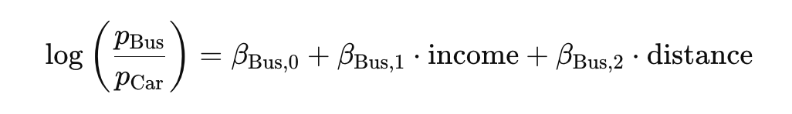
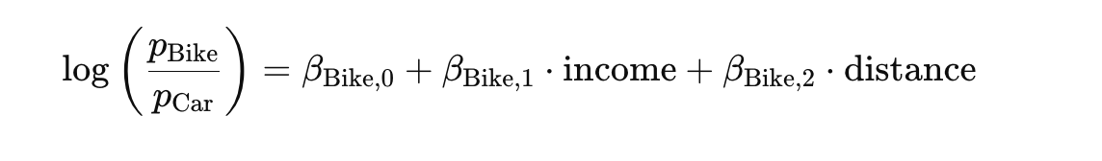
Multinomial Logistic Regression
For our three classes (Car, Bus, Bike), with Car as the baseline, we have the following log-odds equations:

Slide 42
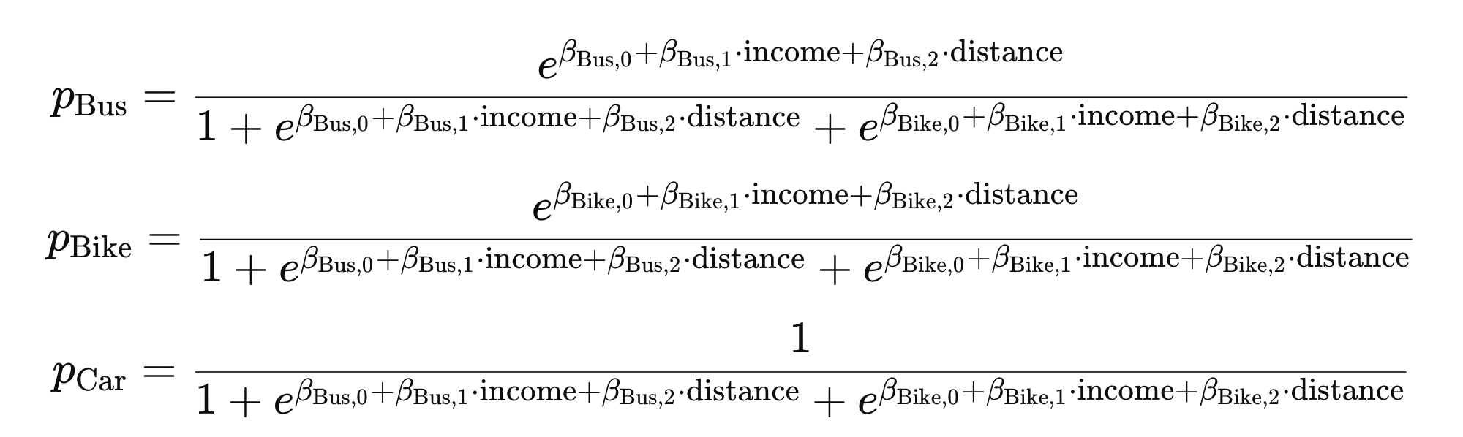
Multinomial Logistic Regression
The probabilities of each class are calculated using the softmax function. The probability of each class is given by:

Slide 43
Multinomial Logistic Regression
pCar​ is the probability that a person chooses a car.
𝑝Bus​ is the probability that a person chooses a bus.
𝑝Bike is the probability that a person chooses a bike.

Slide 44
Multinomial Logistic Regression
In multinomial logistic regression:
You choose one class as the baseline.
You create logistic regression equations for each of the other classes relative to the baseline class.
You use the softmax function to convert the log-odds into probabilities for each class.

Slide 45

Odds Ratio
The odds ratio is a measure of association between a predictor variable and an outcome in logistic regression and other statistical models. It quantifies how the odds of the outcome change with a one-unit change in the predictor variable.
The odds ratio (OR) for a predictor variable 𝑥𝑖 is calculated by exponentiating the corresponding coefficient 𝛽𝑖​ from the logistic regression model:

Slide 46
Odds Ratio
OR > 1: Indicates that as the predictor variable increases, the odds of the outcome occurring increase. For example, an odds ratio of 2 means that for a one-unit increase in the predictor variable, the odds of the outcome occurring are twice as large.
OR = 1: Indicates that the predictor variable has no effect on the odds of the outcome occurring.
OR < 1: Indicates that as the predictor variable increases, the odds of the outcome occurring decrease. For example, an odds ratio of 0.5 means that for a one-unit increase in the predictor variable, the odds of the outcome occurring are halved.

Slide 47
Odds Ratio
Suppose the coefficients are:
𝛽1=0.04 for age
𝛽2=1.5 for smoking status
The odds ratios are:
For age: OR_{age}=𝑒^{0.04}≈1.04
For smoking: OR_{smoke}=𝑒^{1.5}≈4.48
Age: An odds ratio of 1.04 for age means that each additional year of age increases the odds of having the disease by about 4%.
Smoking: An odds ratio of 4.48 for smoking means that smokers have approximately 4.48 times the odds of having the disease compared to non-smokers.

Slide 48
Initialization: The algorithm starts with initial random values for the model's coefficients (also known as weights or parameters). These coefficients determine the importance of each input feature in predicting the outcome.
Hypothesis Function: The logistic regression model uses a sigmoid function to map the linear combination of input features and coefficients to a probability value between 0 and 1. This probability represents the likelihood of the data point belonging to a particular class (e.g., "spam" or "not spam").
Cost Function: The cost function (often the log-loss or cross-entropy loss) measures how well the model's predictions match the actual labels in the training data. The goal is to minimize this cost function.
Gradient Descent: The algorithm employs an optimization technique like gradient descent to iteratively update the model's coefficients in the direction that reduces the cost function. This process continues until the cost function converges to a minimum or a predefined stopping criterion is met.

